Slide 1
Ecommerce prices Analysis
on Noel 2020 holiday
Do Chi Thanh
April 28, 2021

Slide 2
Problem
Question: Do ecommerce platforms really big sale on Noel 2020 holiday?
Answer: NO. SURPRISE!!!

Slide 3
The data
Data collected by crawling from ecommerce websites (lazada, shopee, tiki, sendo) before, during and after the Noel event.
Days of collection:
2020-12-11 (lazada, tiki, shopee, sendo)
2020-12-19 (lazada, tiki)
2020-12-20 (lazada, tiki)
2020-12-23 (lazada, tiki)
2020-12-24 (lazada, tiki)
2020-12-28 (lazada, tiki, shopee, sendo)
Thousands of items across all the categories in each website (25 first pages)

Slide 4
The data
Use data of lazada and tiki for comparison of sale amount during the holiday.
Shopee and sendo data give us some useful insights.

Slide 5
Analysis

Slide 6
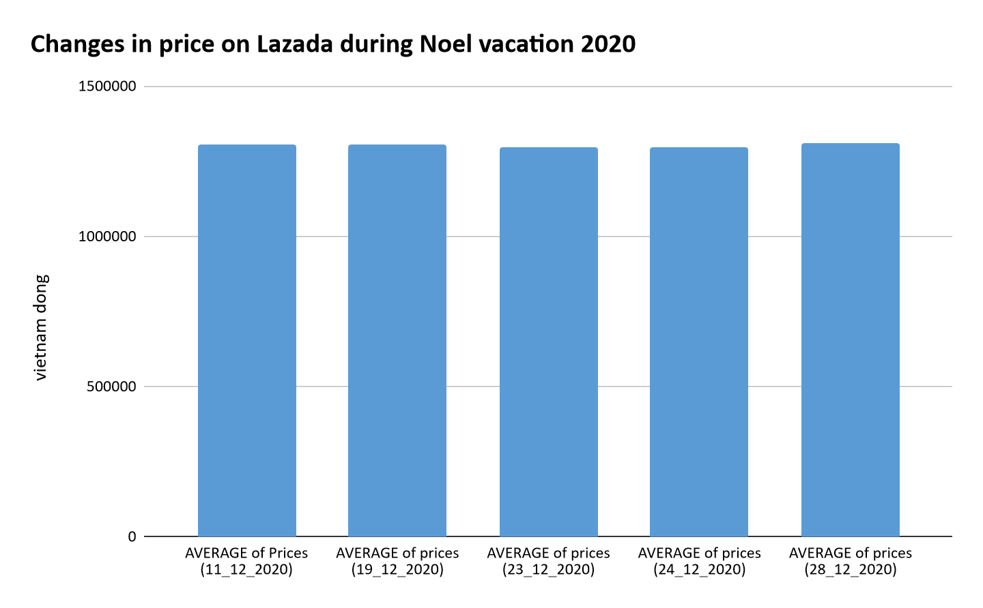

Slide 7
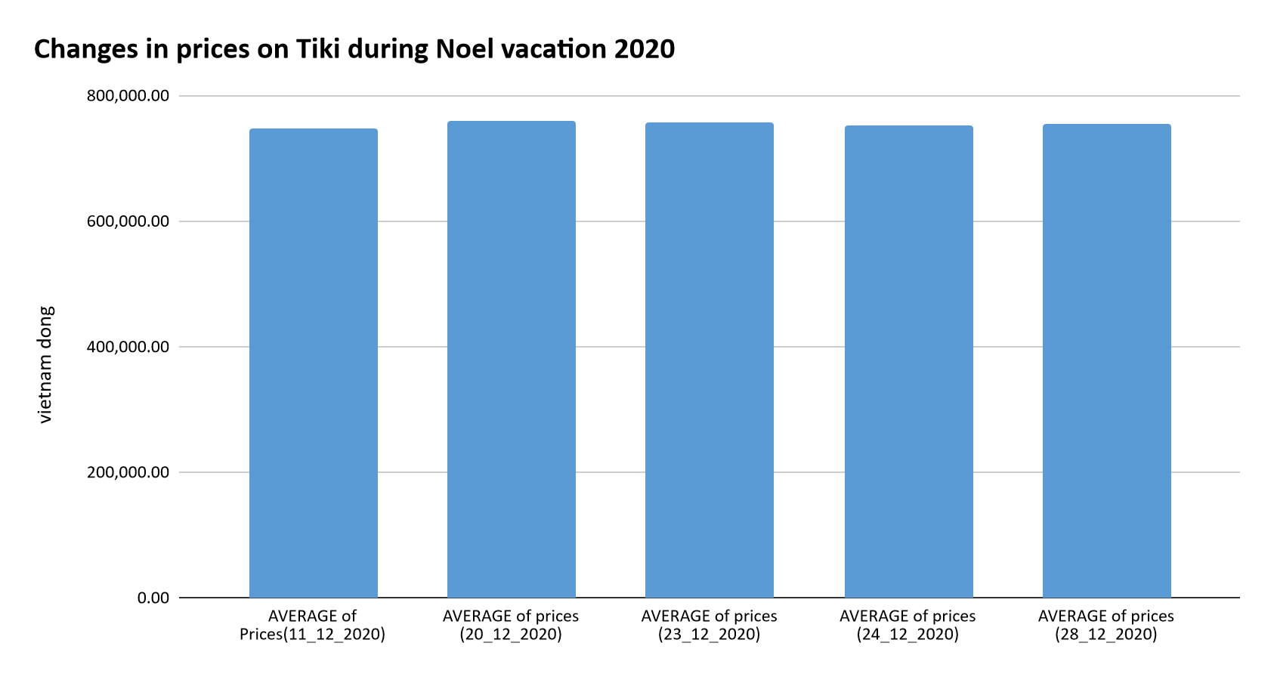

Slide 8
Prices don’t actually sale off during Noel holiday!

Slide 9
Other findings
Prices on shopee are extremely low! It’s maybe apart of their business strategy.
On shopee, list of items change very fast
The common items of 2020-12-11 and 2020-28-11 only equal to ⅓ of the former list.
Average prices on ecommerce websites are very different
Lazada (1.3m vnd) > Sendo (1.05m vnd) > Tiki (0.7m vnd) > Shopee (0.14m vnd)

Slide 10
In summary
There is no big sale on Noel holiday 2020 like ecommerce platforms marketing based on our data.
Limitation:
The ecommerce platforms may offer sales for their customer under vouchers or free ship, so it wasn’t included in our data.

Slide 11
Future works
Consider voucher and shipping fee factor to ensure the accuracy of our result.

Slide 12
Thank you!

